Slide 1
SERVICE PORTFOLIO
FACULTY DEVELOPMENT COMMITTEE
January 6, 2021
Marianne Celano, PhD, ABPP
ANDREW FURMAN, MD
Julie Kable, PhD
NADINE KASLOW, PhD, ABPP

Slide 2
SERVICE
Service is not synonymous with outstanding patient care
Service is distinct from Teaching- only overlap is program director, which is both
Service means going above and beyond
More faculty go up on Service than Teaching

Slide 3
Self-Assessment
Examine the 2017 Guidelines for Appointment, Promotion, and Tenure to determine what level you have achieved at this point and how your service portfolio fits into your overall package
Document what you have done in the area of service or are doing in this area-often this is most neglected area for documentation (often people add things after reviewing the criteria to their vitae)
Document on a regular basis-things are easy to forget
Establish the low-hanging fruit-what is you need to achieve the level of distinction that you need (see page 6 and 9)
Avoid all or none approach to promotion (I can’t do this know so there is no point in looking at it)
Establish a “timeline” that considers your overall life plan

Slide 4
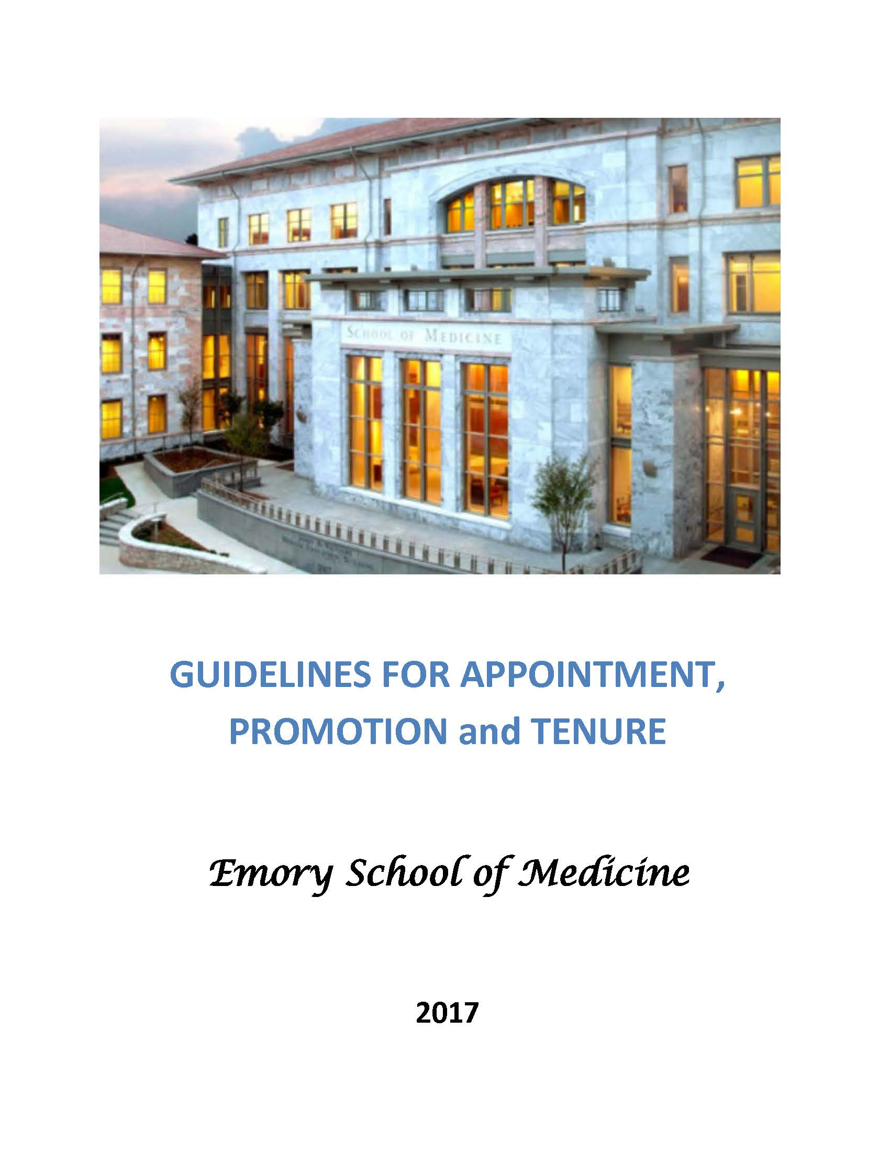
Self-Assessment

Slide 5
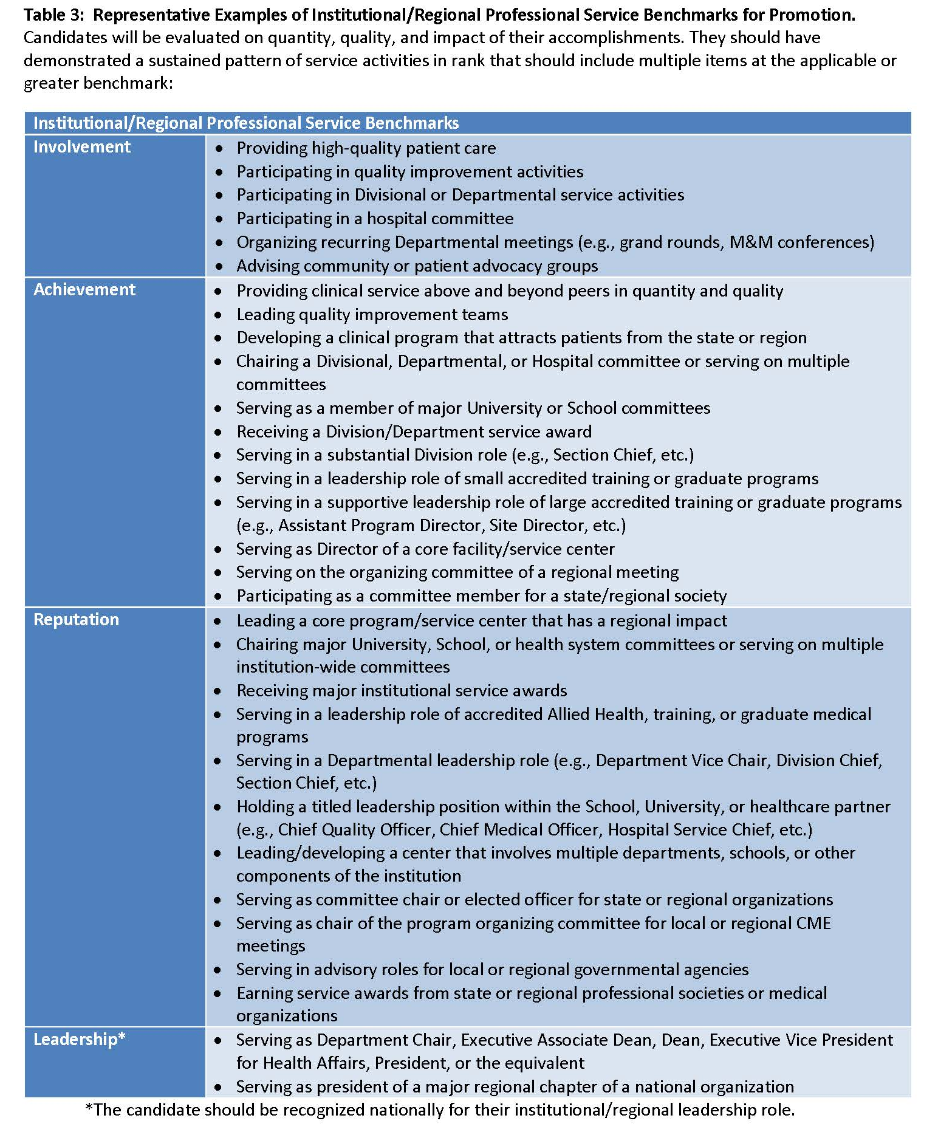
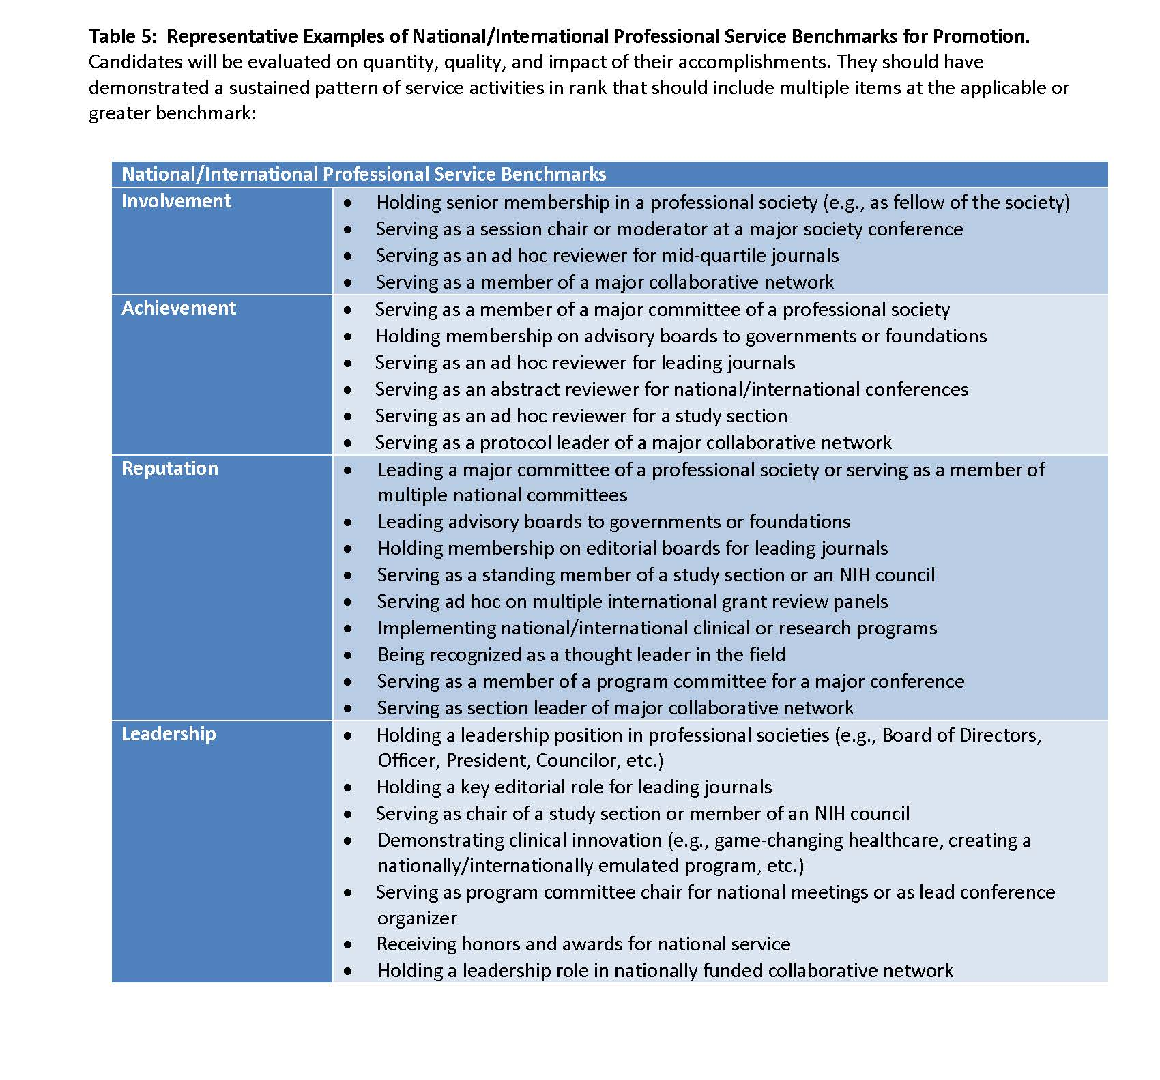
Service

Slide 6
Elements of Service
Evidence of your skill and knowledge (who you see, why your service is special, and awards that you may have received)
Humanistic concern for patients and families (public advocacy)
Collegiality and the innovation application of techniques and knowledge (modifications, changes, improvements, manuals, etc)
Citizenship (committee work, conference organization, peer review (manuscripts and grants)
Letters from people who have seen the benefits of your action

Slide 7
HOW CAN I GAIN VALUABLE EXPERIENCES FOR MY SERVICE PORTFOLIO?
Serve on committees
Departmental
Institutional (e.g., IRB)
Regional
National
International
Review manuscripts submitted for publication (ad hoc, editorial board)
Develop/lead clinical program that attracts patients regionally
Lead accredited training program (counts in education too)
Advise community/patient advocacy groups

Slide 8
HOW CAN I GAIN VALUABLE EXPERIENCES FOR MY SERVICE PORTFOLIO
Build/direct programs
Engage in committee work
Assume administrative roles
Be active/taking leadership roles in professional societies/organizations outside of the institution is very important, and necessary for promotion toa associate professor (regional) or professor (national/international) if area of distinction is Service

Slide 9
WHAT IS YOUR ADVICE FOR CREATING A STRONG SERVICE PORTFOLIO
Start early
Be sure your Service Portfolio exactly matches your CV

Slide 10
WHAT IS YOUR ADVICE FOR CREATING A STRONG SERVICE PORTFOLIO?
Identify your clinical niche and develop a clinical program
Collect data on patient care (number served/year, from where, outcomes)
Ask your mentor or senior faculty members in your specialty how you can:
Get involved in relevant regional and national committees
Review manuscripts or conference program submissions
Identify an opportunity for quality improvement in patient care, assemble a team to fix it
Document all community outreach and service activities
Save emails in which faculty or patients thank you for your clinical service

Slide 11
WHAT IS YOUR ADVICE FOR CREATING A STRONG SERVICE PORTFOLIO
Follow the guidelines exactly
Remember you have 10 pages
Consider 4-5 letters of support
Have letters be only 1 page to maximize their impact

Slide 12
WHAT IS YOUR ADVICE FOR CREATING A STRONG SERVICE PORTFOLIO
Current Administrative/Clinical Appointments
Clinical Service Contributions
Society Memberships
Committee Memberships
Peer Review Activities (grants, manuscripts, conference abstracts)
Editorships and Editorial Boards
Organization of Conferences
Consultantships/Advisory Boards
Service-Related Honors and Awards
Community Outreach (local charities, community clinics, religious or service organizations, media appearances)
Letters

Slide 13
HOW DO YOU SELECT WHO TO SOLICIT LETTERS FROM?
Letters of support for service portfolio (not external referees):
Non-Emory faculty with whom you’ve served on regional/national committees
Emory faculty from a different Department who can attest to the growth and excellence of your clinical program
Journal editors who can comment on your service as a reviewer or editorial board member
Leaders of community/patient advocacy groups who can describe your unique contributions

Slide 14
QUESTIONS AND ANSWERS

