Slide 1
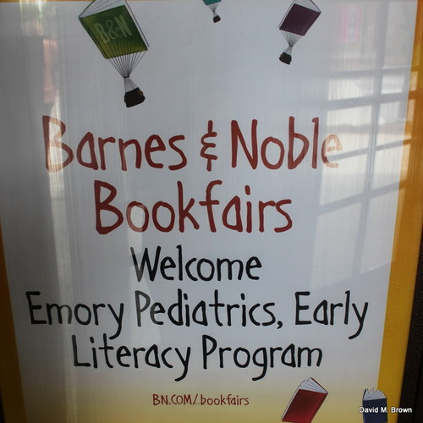
Emory Pediatricians
Promote Literacy

Slide 2
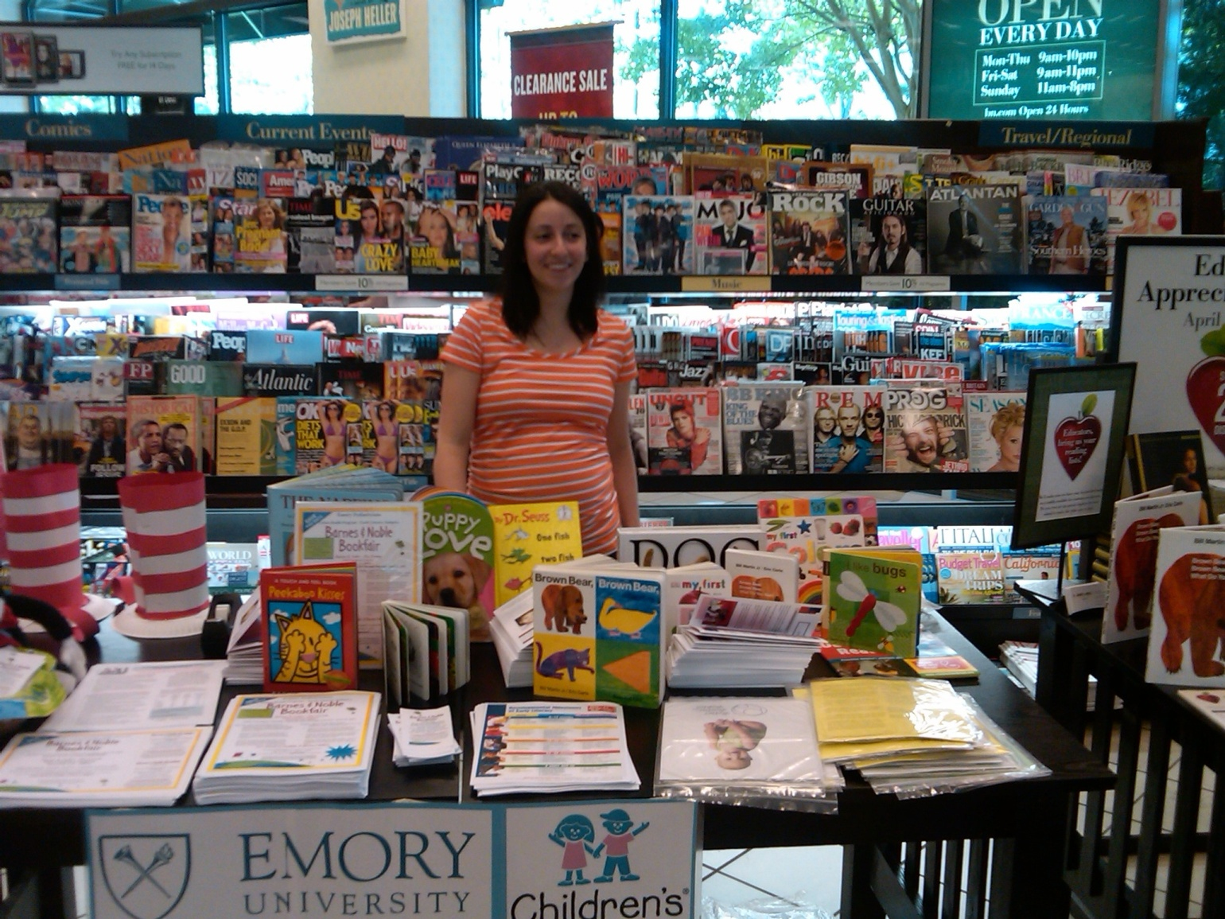
Barnes & Noble Bookfair
In April 2012, Emory’s Urban Health Program hosted a bookfair at Barnes and Noble at the Forum. The event helped raise money for give-away books for patients at Children’s Healthcare of Atlanta at Hughes Spalding. In addition, bookfair activities were designed to raise awareness about the important of early literacy experiences. Emory pediatricians believe in caring for the “whole child” and recognize that reading aloud is one of the most important ways parents can prepare their children to be successful students.
Here is Dr. Laura Babcock promoting the book fair to store customers.

Slide 3
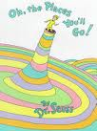
Dr. McFadden-Garden
Dr. McFadden started the second day of the Barnes & Noble Bookfair by performing a motivating read-aloud using Dr. Seuss’s Oh, the Places You’ll Go!

Slide 4
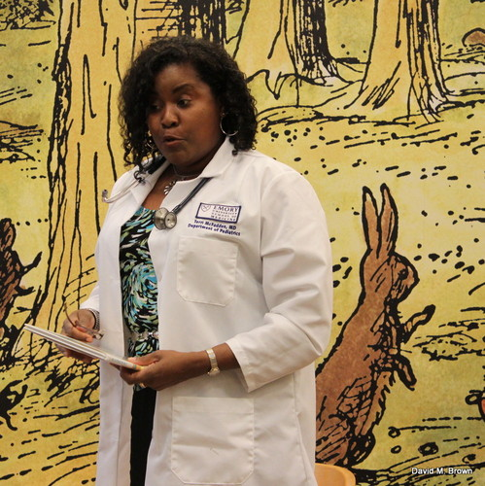
Congratulations!
Today is your day.
You’re off to Great Places!
You’re off and away!
Dr. McFadden encouraged her young audience members to always perform their best in school and remain disciplined with their studies so that they may succeed in life.

Slide 5
Dr. McFadden-Garden informed parents who have children from birth through age five that the most precious gift they can share with young children is reading.
Engaging children in read-alouds helps them to learn how books and print work.
Authors of the research article Before They Read : Teaching Language and Literacy Development through Conversations, Interactive Read-alouds, and Listening Games (2010) recommend that children hear a minimum of three books a day by the time they reach age six.
Dr. McFadden–Garden is the co-founder of the Reach Out & Read Program at Children’s Healthcare of Atlanta at Hughes Spalding.

Slide 6
PERFORMANCE-ORIENTED STYLE
Dr. McFadden-Garden presented the literature in a performance–oriented style, which entertained and engaged the children. Adults utilizing this style employ a variety of dramatic techniques to signal important points or sections of the story, such as:
Varying the pitch and tone of the voice.
Drawing out selected words and phrases.
Using distinctive voices to bring the characters within a story alive.
Changing facial expressions and body language.
Dr. McFadden-Garden made the read-aloud activity exciting by raising her voice to highlight specific phrases, and incorporated a variety of hand movements to express enthusiasm.
The Style of Reading and Reading in Style by Pauline Davey Zeece Early Childhood Education Journal, Vol. 35, No. 1, August 2007

Slide 7
PARENT-CHILD INTERACTION
Story reading is a social process. The quality of the parent-child interactions while reading stories together will influence children’s learning and their attitudes toward reading. Parent-child story reading sessions need to consist of :
Questions prior to reading to prepare the children for the story.
Verbal interactions between the adults and children that relate the story to experiences familiar to the children.
Questions presented after the story that elicit evaluative responses.
Positive reinforcement of the children’s responses.
Parents and children engaging in storybook reading by Olivia N. Saracho and Bernard Spodek, Early Child Development and Care. Vol. 180, No. 10, December 2010, 1379-1389

Slide 8
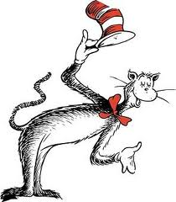
“I was thrilled to observe the children truly engaged in the read-aloud, Oh, the Places You’ll Go!,” stated the Cat in the Hat. He politely tipped his hat and bowed to the children as they were entertained and inspired.

Slide 9
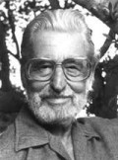
Dr. McFadden-Garden reflected upon the words of the book Oh, the Places You’ll Go as she thought about the patients she serves at Children’s Healthcare of Atlanta at Hughes Spalding. In her heart, she wishes the motivational words of Seuss could be embedded in the minds of all children.
And will you succeed?
Yes? You will, indeed!
(98 and ¾ percent guaranteed.)

Slide 10
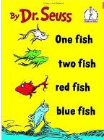
Dr. LaKesha Davison
Dr. Davison presented two storytelling events using the following Seuss books:
During her first read-aloud, Dr. Davison thought about her childhood experiences with Dr. Seuss. Of course, she had to have cookies and milk during her readings as a child.
A small child emerged from the audience as Dr. Davison read One Fish, Two Fish, Red Fish, Green Fish. The toddler wanted to come closer to view the pictures in the book.
Dr. Davison demonstrated to parents that it is important to discuss the pictures in the book to introduce numbers concepts and colors. She encouraged parents to count the number of fish and describe the colors to young children. She informed parents that children’s books are excellent for teaching basic concepts.

Slide 11
Dr. Davison informed parents that there are a variety of ways to provide literacy experiences such as:
Reading stories
Discussing stories
Telling stories
Interacting about stories
Teaching vocabulary
Dramatizing stories
Dr. Seuss is famous for his rhymes.
Books with rhymes help children learn to
listen to the sounds within words. This
skill will help them learn to sound out
words phonetically when they begin
learning to read themselves.
Parents and children engaging in storybook reading by Olivia N. Saracho and Bernard Spodek, Early Child Development and Care. Vol. 180, No. 10, December 2010, 1379-1389

Slide 12
Dr. Davison informed the audience that as a young child her parents read to her within the home. Thus, she helped parents recognize that they are really their child’s first teachers. Parents should introduce the world of shared stories to their children even before their children can walk or talk.
Reading begins in the home!

Slide 13
Enjoy sharing quality children’s literature with young learners. Presenting books in a playful manner allows children to receive a wealth of information.
In addition to early literacy exposure, play is one of the most important activities for a child. Through play, a child explores his world, learns valuable information, and develops social skills. Adults can facilitate young children’s brain development by providing time and space, new experiences and materials, and support to encourage high-quality play.
(Better Brains for Babies, 2011).
Mr. Rogers described play in this way:
Play is often talked about as if it were a relief from serious learning. But for children, play is serious learning. Play is really the work of childhood.

Slide 14
Drs. McFadden-Garden & Davison viewed the large array of children’s literature in the beautiful Barnes & Noble store at Peachtree Forum in Norcross, GA. They also interacted with parents and children by providing enriching literacy strategies.
Children visiting Barnes and Noble enjoyed meeting Drs. Davison and McFadden-Garden as they entertained the children with Seuss literature along with arts and craft activities. The parents were very pleased with the interactions with the pediatricians.

