Slide 1

Understanding Your Responsibilities:
External Activities
COI Disclosures
Industry Relations

Slide 2
Topics
1. SOM Industry Relations Policy
2. Personal external activity requests
3. Annual COI disclosure requirements
4. Emory Intellectual Property Policy
5. Industry gifts
6. Industry-sponsored activities at Emory

Slide 3
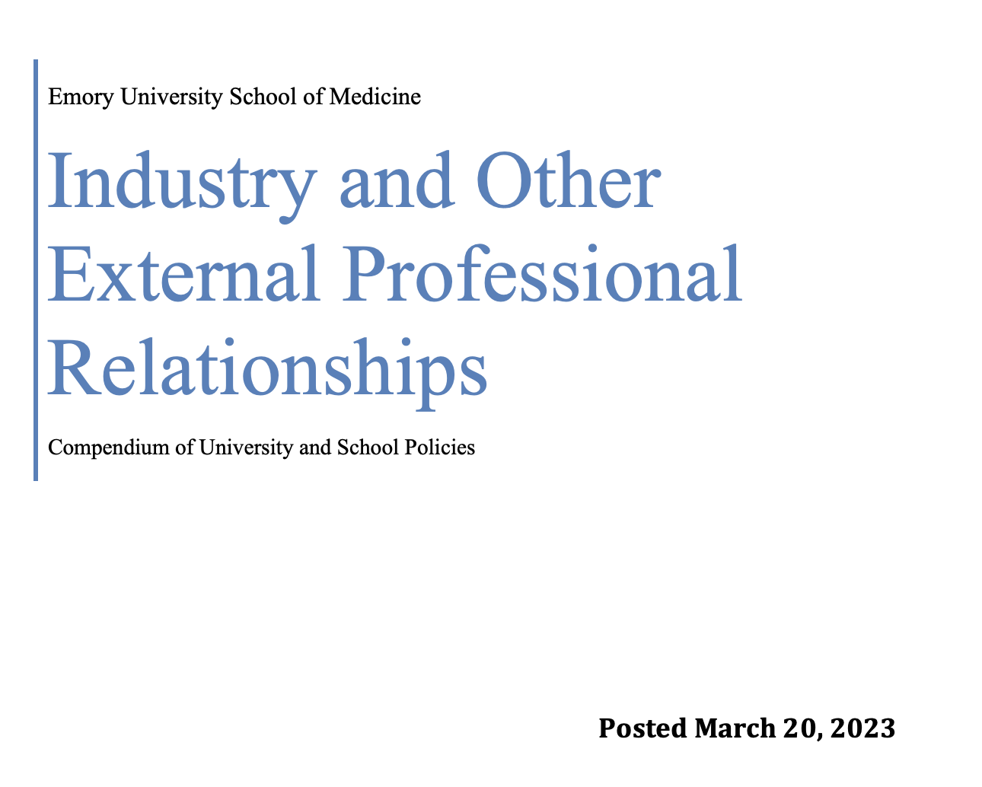
SOM Industry Relations Policy
Full Name: Industry and Other External Professional Relationships: A Compendium of University and School Policies
Purpose: Guidelines for principled involvement with industry and other entities
Link: https://med.emory.edu/about/_files/091818-compendium-updated-060723v2.pdf

Slide 4

What is Considered “Industry?”
Pharmaceutical companies
Medical software companies
Biomedical investment companies
For-profit educational companies
Non-profit foundations sponsored by any of the above
Biotechnology companies
Medical device and medical equipment companies

Slide 5
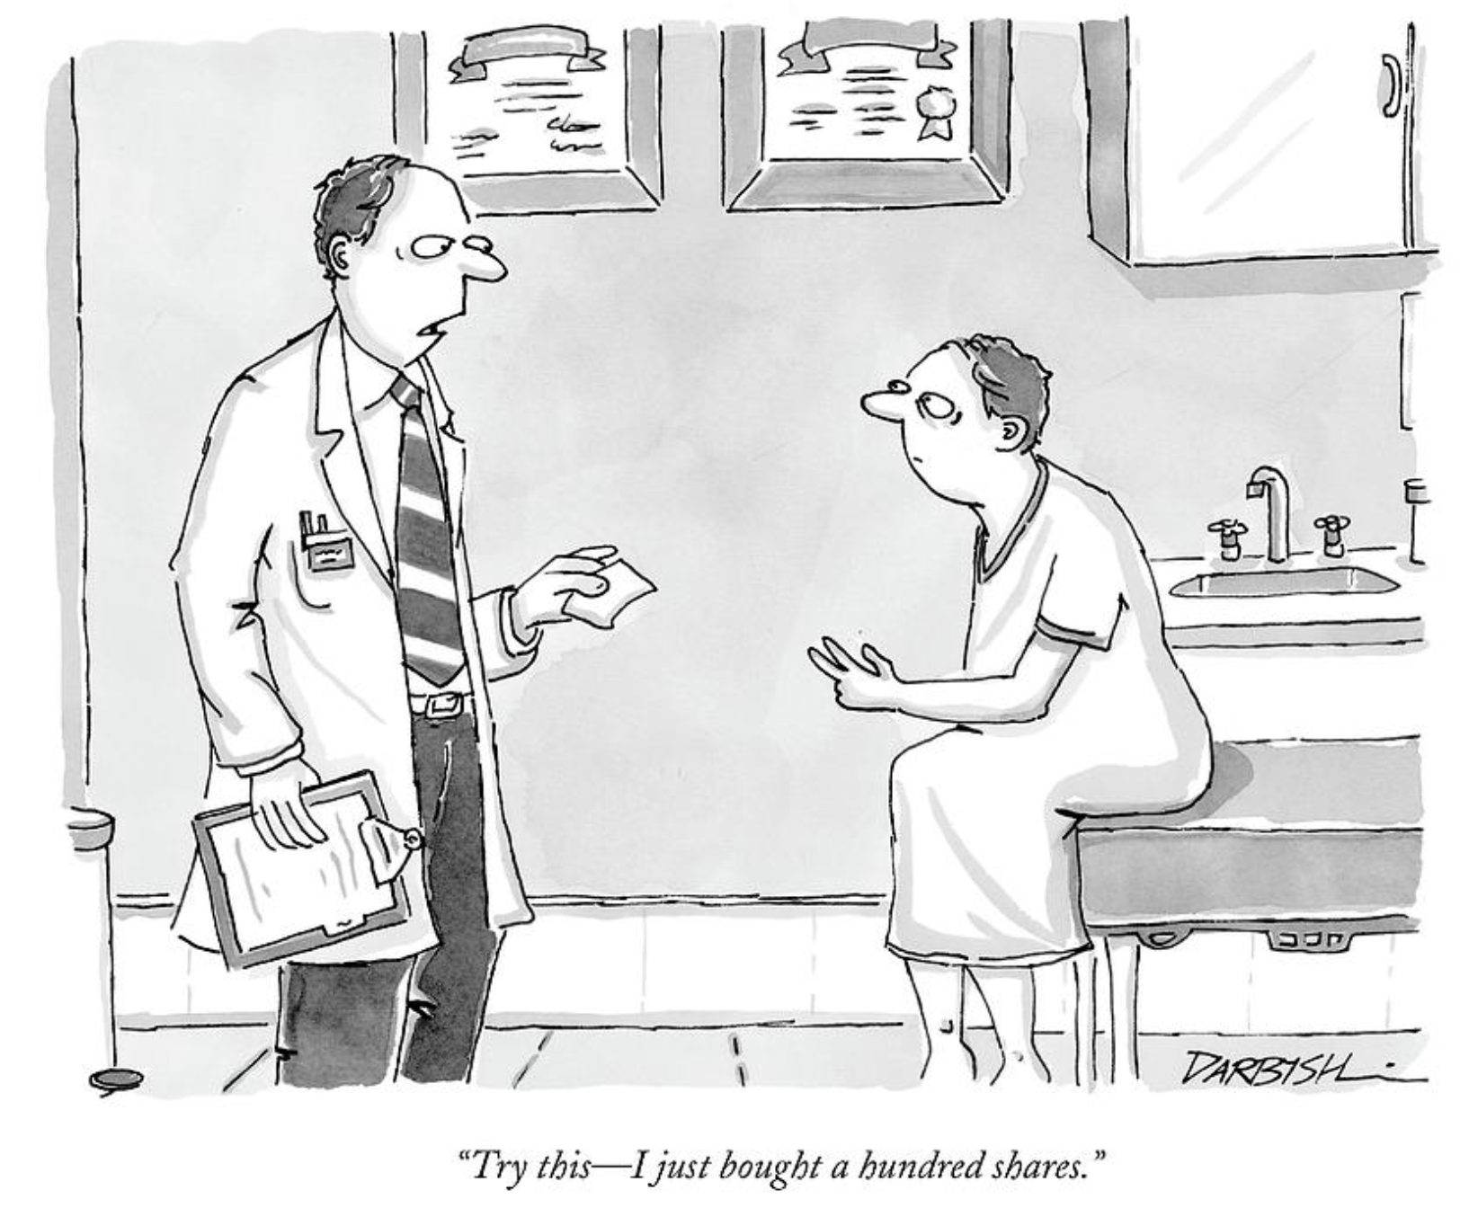
Why Do We Care?
Patient welfare
Protection of human subjects
Research integrity
Public trust & institutional credibility
Role models to students & trainees

Slide 6

Why Disclose?
Required By:
Emory and SOM policies to assess for conflicts of interest related to procurement, internal controls, nepotism, research
U.S. federal government for researchers receiving federal funds
SOM accrediting body (LCME) reviews completion rate when conducting accreditation review
Purpose
Review and mitigation of financial interests/relationships that may create real or perceived conflicts of interest in teaching, research, service, or patient care.

Slide 7

SOM Requirements for Engaging in
Personal External Activities
Who: Faculty
What: Must seek approval before engaging in external activities by submitting a Pre-Approval Request
When: At least 30 days in advance
Where: eDisclose https://ediscloseemory.huronresearchsuite.com

Slide 8
Three Categories of External Activities
Traditional Academic Activities
Activities Generally Permitted
Prohibited Activities
Prior Approval Not Required
Prior Approval Required
Personal External Activities

Slide 9

Traditional Academic Activities
Lectures at U.S. academic institutions
Presentations at U.S. academic professional associations/societies at their formal meetings & conferences
Serving on U.S. government/non-profit advisory panels & grant review bodies
Speaking at ACCME-accredited CME activities sponsored, managed, & hosted at other U.S. academic institutions, U.S. governmental agencies, or U.S. academic professional association/society meetings
Serving as a journal editor or publishing a book
Serving as an examiner for a certifying board
Prior approval not required
Notes:
Written/oral exam – add picture

Slide 10

Scientific/clinical industry consulting
Providing clinical/scientific advice, scientific advisory boards
Clinical events committees, clinical trial steering committees, data monitoring committees
Educational, non-promotional speaking engagements
Industry-sponsored CME
Cadaver labs, physician proctoring at non-Emory facilities
Start-up company
Board member or fiduciary role
Industry-sponsored non-promotional speaking & training
Paid or unpaid appointment at other institution
Expert witness &
legal consulting
Includes both paid and informal, unpaid advice
Includes U.S. and non-U.S. institutions
Including director, officer, trustee roles
Forming or engaging with a start-up company
External Activities Generally Permitted
Prior Approval Required

Slide 11
Paid and Unpaid Appointments
at U.S. or Foreign Institutions
Prior Approval Required
Until appointment is approved, refrain from:
  Signing an agreement, appointment letter, or other document
  Accepting payment
  Including the affiliation/title on your CV or publications
  Participating in any services for that institution
If paid, must execute a 3-way agreement between faculty, Emory, and other institution

Slide 12

Promotional advice
Marketing or sales advice
Business strategy or investment advice
Educational presentation at promotional event (e.g., trade show)
Promotional presentation at educational event (e.g., scientific conference)
Accepting compensation, travel, tuition waivers to attend industry event if not providing services under approved external activity
Practice of medicine or any licensed healthcare profession
Providing clinical services
Owning a medical practice
Participating in speakers bureaus
Including name on ghost-written article
Research/serving as an investigator
Promotional speaking
Attending industry events for pay
Listening to sales talks for pay
Telehealth
Creating marketing/promotional materials
Prohibited
External Activities
Notes:
AcceMarketing or sales advice
Market research surveys
Listening to sales presentations for pay
Educational presentations at promotional events (e.g., trade show)
Accepting compensation, travel costs, tuition waivers to attend industry-sponsored event if not providing services for an approved external activity

Slide 13
External Activity Review Process
Additional Reviews
Expert witness/legal consulting: Reviewed by Office of Risk & Insurance Services
International travel: Reviewed by Export Control & Research Security
If prescribe products of or refer patients to entity: Reviewed by EHC Compliance
Pediatrics Institute faculty: CHOA reviews by committee at department-level and CHOA legal reviews expert witness/legal consulting
1. Submit Request via eDisclose
2. SOM Department Review
3. SOM Dean’s Office Review and Revisions
4. Additional Review (if applicable)

Slide 14

Intellectual Property Policy (7.6)
Emory owns all intellectual property (IP):
  Developed by faculty, staff, and post-graduates that is related to the individual’s normal duties, course of studies, field of research or scholarly expertise or was made with the use of Emory Support including when developed through external consulting activity.
Emory may agree to surrender its claim to such IP under certain circumstances, which include, among others that no Emory support was utilized.
Emory IP Policy

Slide 15
Conflict of Commitment (COC)
What is COC?
When an employee’s external activities interfere with their professional responsibilities to Emory
Why is COC a problem?
Overcommitment of time
Nature of activity at odds with Emory role
Use of Emory resources for activity
Primary professional allegiance to SOM & Emory & its missions in education, service, scholarship
When might COC occur?

Slide 16

Requirement to Complete Annual
Conflict of Interest (COI) Disclosure
Who: Faculty and Staff
What: Must complete an annual COI disclosure form
When: December 1, 2025 – February 28, 2026
Where: eDisclose (https://ediscloseemory.huronresearchsuite.com/)

Slide 17
What to Disclose?
All compensation received from participation in personal external activities
Forms of compensation include money, travel expenses, equity
There is no minimum dollar threshold under the SOM policy
For researchers, there are additional requirements under Policy 7.7. Guidance on this policy is provided by RCRA, who can be reached at edisclose@emory.edu.
Note: The financial information reported in Pre-Approval Requests is anticipated compensation. The annual disclosure is to disclose actual compensation received.

Slide 18
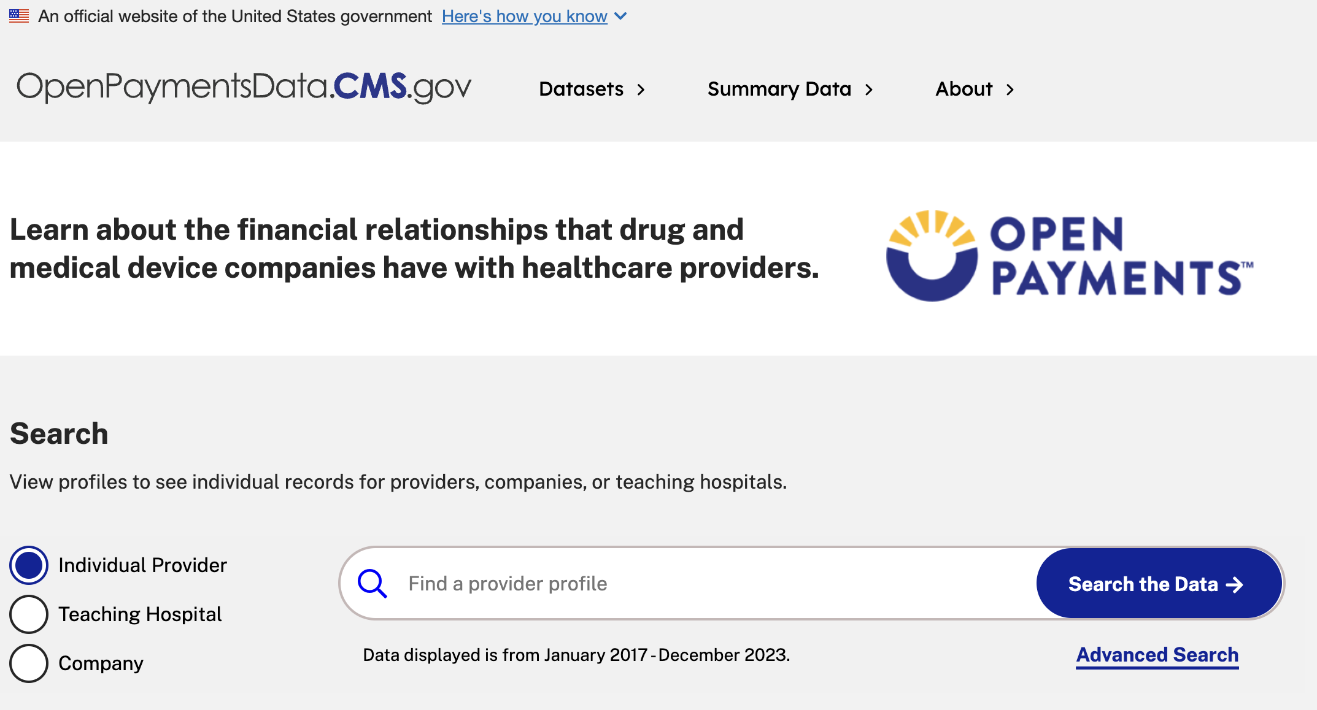
CMS Open Payments
Drug and Device companies are required by the Sunshine Act to report payments made to physicians on a publicly accessible website.
1
2
Emory reviews this data and compares it to information it has received from you.
https://openpaymentsdata.cms.gov/
Annual Disclosure

Slide 19
Research COI/COC
Emory Healthcare Compliance
University Ethics and Compliance
Children's Hospital of Atlanta
Reviews faculty and staff approved external activities & annual disclosures for research COI
Reviews faculty physician annual disclosures from clinical perspective & external activities if refer patients to/prescribe drugs of entity
Reviews Pediatrics Institute external activities at department-level review
Reviews staff COI disclosures
Issues management plans
Intersection with Other Offices
Intersection with Other Offices

Slide 20

Individuals Cannot Accept Industry Gifts
Studies show that gifts:
  Elicit feelings of reciprocity
  Influence decision making, including Rx writing
  Create a perception of bias
Industry gifts include:
  Travel costs (flight, hotel, per diem)
  Meals
  Tuition waivers for courses
  Books or journal subscriptions
  Tickets
  Pens or pads

Slide 21

SOM Welcomes Principled Industry Gifts to the Institution
Gifts to the institution of funds, equipment, and supplies are welcome
  To solicit and accept institutional gifts, contact the Office of Advancement and Alumni Engagement
  For medication donations, contact Emory Healthcare Pharmacy
Gifts should not:
  Be solicited or accepted for specific activities (except CME)
  Be given for the benefit of an
  individual

Slide 22
Hosting Industry-Sponsored Activities at Emory
Activity | Requirement
Industry-sponsored clinical case observations | Approval by Department Chair and Emory Healthcare leadership Contract between SOM, Emory Healthcare, and company. Company pays Emory for Emory physician to train non-Emory physician to use company products.
Access to Emory facilities by industry representatives | Must be invited by faculty or senior staff for legitimate purpose (e.g., sales, servicing equipment, demos, training Emory personnel on devices/equipment, providing product information in group-setting) In general, not permitted in patient care or public areas. For SOM-initiated education, complete Appendix B form and send to Nicole.Tannebaum@emory.edu
Industry-sponsored academic conferences at Emory | Non-CME: Agreements reviewed and executed through Emory’s Office of Advancement & Alumni Engagement. To the extent possible, conference should conform to the ACCME guidelines. CME: Managed by Emory’s Office of CME. Contact Assoc. Dir., Programs, Karlotta Brown for assistance.

Slide 23

Research Staff
Policy 7.7 requires anyone involved in the design, conduct, or reporting of research to complete an annual COI disclosure
Policy 7.38 requires postdocs, trainees. and research staff to seek prior approval for paid and unpaid professional activities including:
Any outside employment with duties similar to your Emory duties
Board service (board of directors, SAB, other)
Participation in a foreign government-sponsored talent program
For more information, visit https://rcra.emory.edu/coi/policies.html or contact eDisclose@emory.edu
Non-Research Staff
Contact your HR representative for guidance
Relevant University Staff Policies

Slide 24
Contact Information
Nicole Tannebaum, JD, MSPH
Director, Faculty Affairs Administration
nicole.tannebaum@emory.edu
Grace Ahn
Manager, Faculty Affairs Administration
Grace.ahn@emory.edu

